Slide 1
Electricity supply board
Database software

Slide 2
Project overview
The project is a web based application where users can get instant electricity bill and pay them online via credit card.
The system automates the conventional process of paying electricity bill by visiting the place where Users have to stand in queue.
The system would be having two logins admin and user login, through an online web based portal.
A field engineer has to feed the system with electricity usage data into respective users account.
The system then calculates the electricity bill for every user and updates the information into their account every month.

Slide 3
Project features
User login
Admin login
Bill Calculation
Payment option
Email Notification

Slide 4
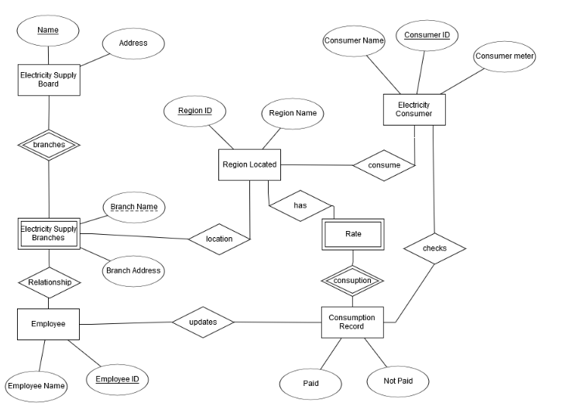
ER diagram

Slide 5
ADVANTAGES
The system excludes the need of maintaining paper electricity bill as all the electricity bill records are managed electronically.
Administrator doesn't have to keep a manual track of the users. The system automatically calculates fine.
The system excludes manual bill calculation.
Users don’t have visit the office for bill payment.
There is no need of delivery boy for delivering bills to users place.
Thus, it saves human efforts and resources.

